Slide 1
E-Waste Stakeholder Consultative Seminar
Siemens Auditorium- Midrand
4 July 2018
www.eranpc.co.za

Slide 2
Welcome and Introduction
Purpose
Introduce you to ERA E-Waste Recycling Authority NPC
Introduce you to ERA’s E-Waste Industry Waste Management Plan (IndWMP)
Get your feedback and input as a key stakeholder
To elicit your participation as a subscriber (you might be legally obligated, once it is promulgated, to subscribe to a/the Plan)
To fulfill a legally prescribed condition for all IndWMPs
ERA NPC has developed an E-Waste Industry Waste Management Plan which ERA NPC intends submitting to the DEA as the national plan for managing E-Waste.
ERA NPC invites all stakeholders to make input into the ERA E-Waste IndWMP, and to become a Member of ERA E-Waste Recycling Authority NPC.
We assure you that even though extensive debate and work has gone into formulating the Plan, your views will be seriously considered and integrated where possible.
www.eranpc.co.za

Slide 3
Process of Engagement
www.eranpc.co.za

Slide 4
Stakeholders of the E-Waste Value Chain
PRE-Consumer
EEE producers (incl. EEE and UEEE Importers)
Distributors (Retailers)
POST-Consumer
Collection
Informal collectors (Tier 4)
Transportation
Consumer
Public (Government)
Private (Business)
Private (Households)
Transporters
Collection
Collection facilities
Drop off and Buy back (Tier 3)
Recycling
Recyclers
End-use
Processors / Exporters
Large recyclers (Tier 1)
Small recyclers (Tier 2)
www.eranpc.co.za

Slide 5
Who is invited?
Producers – 39/54
ITA - 200
SADA – 8/8
SAEWA – 19/21
Recyclers – 39/46
Government – 312/430 (mostly municipalities)
2 National Advertisements
Members’ Websites
Registered = Steercom +6
www.eranpc.co.za

Slide 6
The IndWMP Process So Far
2nd Draft Plan – October 2014 to June 2015
Submitted to the DEA in June 2015 for feedback and revision
Formal feedback on the Draft Plan was only given 9 months later in April 2016
On 12 August 2016, - Minister of Environmental Affairs issued a Section 28 Notice
Notice was withdrawn a month later.
Final Section 28 Notice issued on 6 December 2017
Notice required all manufacturers (and other stakeholders legally defined as a “Producer”) to register with DEA by 6 February 2018
www.eranpc.co.za

Slide 7
The IndWMP Process So Far
“Producer” means any person or category of persons or a brand-owner who is engaged in the commercial manufacture, conversion, refurbishment or import of new and/or used electrical and electronic equipment which is intended for distribution in the Republic of South Africa.
Notice also requires that an e-Waste IndWMP be submitted by 6 September 2018
Producer can submit its own Plan, but a registered Product Responsibility Organisation (PRO) would stand the best chance of having their Plan adopted and promulgated.
Submit Plan or subscribe to an IndWMP by 6 September 2018 - you will be legally required to subscribe to and co-finance the implementation of an IndWMP
www.eranpc.co.za

Slide 8
Background to the ERA Steering Committee
ERA is a non-profit organisation that was formed out of the e-Waste Industry Waste Management Plan (IndWMP) Steering Committee.
Elected on 29 October 2014 - at least hundred delegates who attended the e-Waste Consultative Conference convened by the Department of Environmental Affairs (DEA)
The committee members mandated to develop an e-Waste IndWMP as contemplated in Sections 28(1) and 28(5) of the National Environmental Management: Waste Act No. 59 of 2008
The ERA Steering Committee (Steercom) comprises of representatives of the ICT and White Goods manufacturing sector, small and large e-Waste refurbishers/recyclers as well as key representatives of the relevant industry associations along the entire e-Waste value chain.
www.eranpc.co.za

Slide 9
Background to the ERA Steering Committee
Members that were duly elected in 2014 and who (continue to) serve on the ERA Steercom Team are (in no particular order):
Producer – Information Technology Association - Ruben Janse van Rensburg
Producer – Information Technology Association - Jonathan Perry
Small Recycler / Social Entrepreneur- Ashley du Plooy
Industry Association – Southern African E-Waste Alliance (SAEWA) - Susanne Karcher
Recycler – e-Compliance - Jonathan De Vries
Metallurgical Processor – SA Precious Metals - Dion Smith
Recycler – Sims and WeCare - Allan Werth
Lighting Recycler – Ewaste Africa - Pravashen Naidoo
Recycler – Africa Ewaste - Ulze van Wyk
Recycler –DESCO - Jan Barnard
Producer / Retailer Association – Small Appliances Development Association - Mark Saunders
www.eranpc.co.za

Slide 10
www.eranpc.co.za

Slide 11
Key Statistics on ERA Members
PRODUCERS
SADA – 8 Members – South African Domestic Appliances Association Representing Manufacturers and Importers of large and small appliances in SA Account for between 70% and 80% of Domestic Appliances on the SA market
ITA – 200 Members – Information Technology Association
Account for around 50% of ICT on SA market
RECYCLERS
Sims – World’s largest E-Waste Recycler – ½ largest in SA
Desco – SA oldest E-Waste Recycler (1992) – ½ largest in SA
SAEWA – Alliance of 21 members – development of emerging E-Waste enterprises
Africa E-Waste, E-Waste Africa (lighting) and e-Compliance – Tier 2 E-Waste enterprises
WeCare – pilot Tier 3 E-Waste enterprises
SA Precious Metals – E-Waste processor
Collectively account for more than 50% of E-Waste collection and recycling
www.eranpc.co.za

Slide 12
ERA NPC / PRO Structure
ERA is a non-profit company (NPC) formed in terms of the Companies Act, No. 71 of 2008 to administer the E-Waste IndWMP. ERA is the shortened name for E-Waste Recycling Authority. Its function is that of a Product Responsibility Organisation (PRO).^{[1]}
The choice of “Product Responsibility” is a departure from the global Extended Producer Responsibility (EPR) concept of “Producer Responsibility” and is made deliberately to reflect the inclusion of a wide range of stakeholders in the E-Waste management system. Among the key stakeholders are the following:
Producers (including EEE OEMs, importers, local manufacturers)
EEE Retailers and distributors
E-Waste collectors
E- Waste refurbishers, dismantlers and recyclers
E- Waste processors
E- Waste consumers
E- Waste disposal facilities
The SA government
www.eranpc.co.za

Slide 13
ERA as a Non-Profit Company
Directors and staff of the ERA need to ensure that no sensitive and anti-competitive trade data is disclosed, wittingly or unwittingly, to any party, where such disclosure can prejudice or be can be reasonably anticipated to prejudice that party in the market-place
The most appropriate organizational format as the E-Waste IndWMP is a public interest Plan dealing with the problems of the “commons”/public
8
1
An NPC’s shareholders are technically public interest groups – accommodates the multi-stakeholder nature & cooperative governance framework of the Plan
Clear safeguards against conflicts of interest & corrupt behavior will be developed by the board of ERA
7
2
6
At no stage may a director be involved in a determination or award wherefrom s/he stands to gain personally & financially
The assets of the company will always serve the goals of a similar organization (in the event of liquidation)
3
5
4
Directors of the company may also only be fairly remunerated for the services which they render to the company
Directors of the company may not share in the profits of the company
www.eranpc.co.za

Slide 14
Composition of ERA Board
Board members of ERA will comprise ten office bearers of which one will be the ex-officio Managing Director.
Remaining 9 office bearer positions will be made up of two nominees from the following sectors:
Producers’ Associations (importers, OEMs and manufacturers)
Recyclers’ Associations
Retailers’ Associations
The remaining 3 office bearers will be nominated from among community enterprise interests, as well as expertise from the legal, financial or academic fields.
www.eranpc.co.za

Slide 15
Why the IndWMP?
Address Effective E-Waste Management
Properly Costed E-waste Management
Producer Pays principle – EPR
Producer = Obligated Party
Avoid Landfill – Safe & Beneficial Recycling
NEMWA Act No. 59 of 2008 / Amend No. 26 of 20014
Section 28 Notice - 6 December 2017
Call for E-Waste IndWMP
Applying National Pricing Strategy for Waste Management
Call for Producers to register with DEA
Specify what IndWMP must address
www.eranpc.co.za

Slide 16
Pricing Strategy for Waste Management
www.eranpc.co.za

Slide 17
Electronic & Electrical Equipment
Equipment which is dependent on electric currents or electromagnetic fields in order to work properly and equipment for the generation, transfer and measurement of such currents and fields and designed for use with a voltage rating not exceeding 1 000 volts for alternating current and 1 500 volts for direct current.
1 | LARGE HOUSEHOLD APPLIANCES
2 | SMALL HOUSEHOLD APPLIANCES
3 | IT AND TELECOMMUNICATIONS EQUIPMENT
4 | CONSUMER EQUIPMENT AND PHOTOVOLTAIC PANELS
5 | LIGHTING EQUIPMENT*
6 | ELECTRICAL AND ELECTRONIC TOOLS (WITH THE EXCEPTION OF LARGE-SCALE STATIONARY INDUSTRIAL TOOLS)
7 | TOYS, LEISURE AND SPORTS EQUIPMENT
8 | MEDICAL DEVICES (WITH THE EXCEPTION OF ALL IMPLANTED AND INFECTED PRODUCTS)
9 | MONITORING AND CONTROL INSTRUMENTS
10 | AUTOMATIC DISPENSERS
Note: Since lighting equipment (category 5 above), is being dealt with as a specialized waste stream requiring its own IndWMP
www.eranpc.co.za

Slide 18
How Much E-Waste?
"An estimated 44.7 million tons of E-Waste is generated worldwide on a yearly basis."
-Lydall M., Wonder N. , Yulandi J., 2017. Mapping South Africa’s Waste Electrical and Electronic Equipment (WEEE) Dismantling, Pre-Processing and Processing Technology Landscape.
"More recent E-WASTE generation estimates provided by the reputable United Nations University suggests that South Africa generates around 300 000 tons of E-Waste per annum."
-Baldé, C. P., Forti, V., Gray, V., Kuehr, R., Stegmann, P., 2017. The Global E-waste Monitor 2017: Quantities, Flows, and Resources, Bonn, Geneva, Vienna: United NationsUniversity (UNU), International Telecommunication Union (ITU) & International Solid Waste Association.
"The wide gap in E-Waste generation estimates has led the ERA Members to apply their collective knowledge to arrive at the negotiated working assumption of this IndWMP, viz. that South Africa currently generates 360,000 tons of e-Waste p.a.
"ERA estimates that between 25,000 and 35,000 tons of E-Waste is currently recycled annually. That is, between 7% and 9.7%."
The ERA IndWMP also proposes to support the recycling of 26% of all E-Waste generated by 2023.”
www.eranpc.co.za

Slide 19
Current E-Waste Recycling Rates
www.eranpc.co.za

Slide 20
Current E-Waste Recycling Rates
www.eranpc.co.za

Slide 21
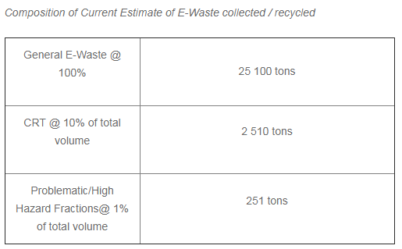
Composition of E-Waste Recycled
www.eranpc.co.za

Slide 22
Requirements of the IndWMP
Social
(job creation)
Manageable
Equitable
Sustainable
Environment
Economic
Viable
www.eranpc.co.za

Slide 23
ERA E-Waste Recycling Target – 5 Years
Year | e-Waste Collected | e-Waste Collected @ 30% p.a. escalation | No. of Additional tons e-Waste Collected (Year-on-Year)
 | (Tons p.a.) | ROUNDED-OFF | Only Year-on-Year Additional e-Waste Collected
Current | 25,000.00 | 7% of actual 360,000 tons generated p.a.
Year 1 | 32,500.00 | 33,000.00 | 8,000.00
Year 2 | 42,250.00 | 43,000.00 | 10,000.00
Year 3 | 54,925.00 | 55,000.00 | 12,000.00
Year 4 | 71,402.50 | 72,000.00 | 17,000.00
Year 5 | 92,823.25 | 93,000.00 | 21,000.00
TOTAL | 318,900.75 |  | 26%
www.eranpc.co.za

Slide 24
Enterprise development
IndWMP Enterprise Support / Development Targets
Household, street and landfill collection
3
4
Logistics network through e-waste transporters
Capital and Operations per existing drop-off point / collection bin
2
5
E-waste Call service
1
6
Buy-back Centres Capital support
Inspectorate
Enterprise development
www.eranpc.co.za

Slide 25
Enterprises Supported -5 Years

Slide 26
Industry and Public participation
Each red dot indicates a Tier 1 recycling site; estimated 17 sites over 5 years
www.eranpc.co.za

Slide 27
Industry & Public participation
Each red dot indicates a Tier 1 recycling site; estimated 17 sites over 5 years
Each yellow dot indicates a Tier 2 recycler; estimated 60 recyclers over 5 years
www.eranpc.co.za

Slide 28
Industry & Public participation
Each red dot indicates a Tier 1 recycling site; estimated 17 sites over 5 years
Each yellow dot indicates a Tier 2 recycler; estimated 60 recyclers over 5 years
Each green dot indicates a Tier 3 Small Business Enterprise; estimated 840 enterprises over 5 years
www.eranpc.co.za

Slide 29
ERA IndWMP Jobs Supported
www.eranpc.co.za

Slide 30
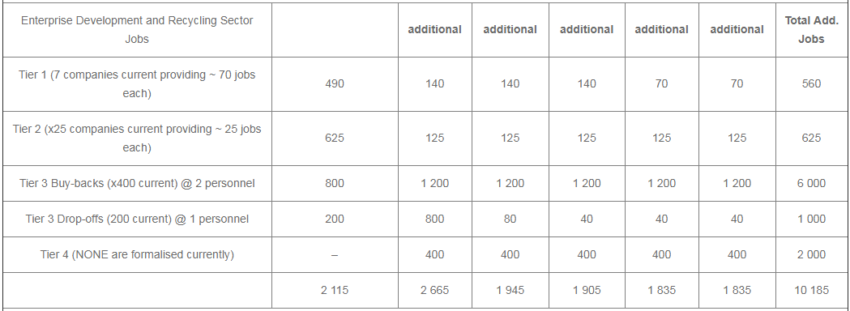
www.eranpc.co.za

Slide 31
www.eranpc.co.za

Slide 32
Tier 1
Tier 2
Tier 3
Tier 4
0
1 000
2 000
3 000
4 000
5 000
6 000
7 000
8 000
9 000
10 000+
Jobs per Tier over 5 years
ERA IndWMP Jobs Supported – 5 Years

Slide 33
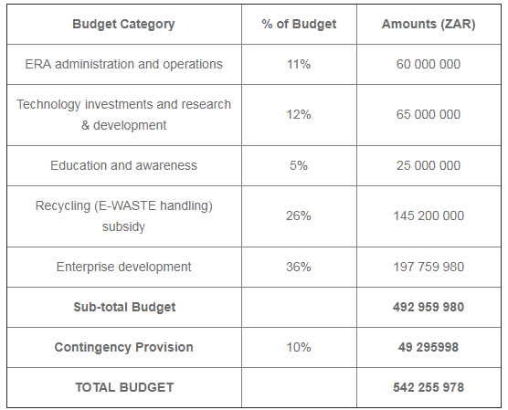
ERA IndWMP Budget / Resource Allocation

Slide 34
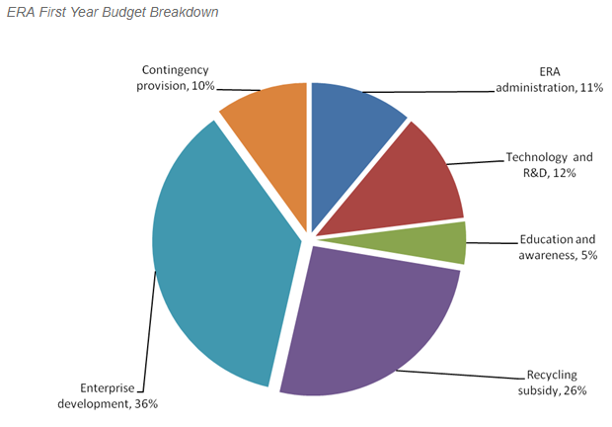
www.eranpc.co.za

Slide 35
Disbursement summary
37%
ERA ADMIN &
OPERATIONS
TECHNOLOGY
& R&D
26%
ENTERPRISE DEVELOPMENT
11%
12%
5%
RECYCLING
SUBSIDY
EDUCATION &
AWARENESS

Slide 36
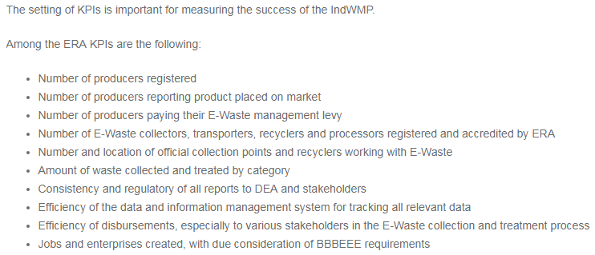
ERA Key Performance Indicators
www.eranpc.co.za

Slide 37
High Level Target of IndWMP
Establishment & Implementation unified E-WASTE management system
Establishment of national E-WASTE management authority to implement the ERA E-WASTE IndWMP
Assist the Waste Bureau to regulate all stakeholders involved in E-WASTE generation, recycling and disposal.
Define key stakeholders - the roles that they are expected to play – register & accredit - to participate in the E-WASTE management system.
Clarify the challenges and opportunities presented by E-WASTE, and the desired outcomes & approaches
Setting targets for E-WASTE collection, recycling, processing and disposal.
www.eranpc.co.za

Slide 38
High Level Target of IndWMP
The setting of the ERA operational budget and initially to be levied equally on all imported and locally manufactured EEE placed on the South Africa market, whether new or 2nd hand.
The establishment of programmes and activity aimed at addressing the challenges and opportunities presented by E-WASTE
Ensure the equitable and sustainable application of resources accruing from the E-WASTE management levy to support these programmes and activities.
Be accountable to all contributing stakeholders, government and the public for the disbursement of the E-WASTE management levy and the results achieved through the adoption and implementation of the ERA E-WASTE IndWMP.
See Pages 68 – 70 of the IndWMP for ERA NPC Objectives
www.eranpc.co.za

Slide 39
Thank you for attending
Please feel free to direct any further queries to :
erainfo@eranpc.co.za / ashley@eranpc.co.za
032 947 0165 / 078 533 2286
www.eranpc.co.za
www.eranpc.co.za

